Slide 1
OBJECT ORIENTED PROGRAMMING
Dr. Raghavendra Achar
Dept of I&CT
Cabin No: 21

Slide 2
Introduction
The birth of modern programming language C, the need for C++, Java, Importance of Java in the internet, security, portability, the byte code. An overview of Java, OOP, Two paradigms, abstraction, the three OOP Principles.
Data Types, Variable and Arrays
Simple types, integers, floating point types, characters, Booleans, variables – declaring variable, dynamic initialization, the scope and life time of variables, type conversion and casting, arrays-one dimensional arrays and multi-dimensional arrays.

Slide 3
Operators and control statements
Arithmetic operators, bitwise operators, relational operators, logical operators, assignment operators, ternary operators, operator precedence. Control statements – if, switch, while, do-while, for nested loops, break, continue.
Classes and Inheritance
Class fundamentals, declaring objects, assigning object references variables, introducing methods, constructors, overloading method, using objects as parameters, argument passing, returning objects, recursion, use of static and final key word, nested and inner class, using command line arguments. Inheritance – basics, using super, creating a multi-level hierarchy, when constructor are called, method overriding, dynamic method dispatch, using abstract classes, using final with inheritance, Wrapper classes.

Slide 4
Packages and Interfaces
Packages, defining a package, use of CLASSPATH, package example, access protection, importing packages, Interfaces – defining an interface, implementing interfaces, applying interfaces, variables in interfaces, extending interfaces.
Array list and Vectors
The list interface, Array list class, obtaining an array from an array list, Vector.
String Handling
String constructors, string length, special operations, character extraction, string comparison, searching strings, modifying a string, string buffer, string tokenizer.

Slide 5
Exception Handling
Fundamentals, exception types, uncaught exception, using try and catch, multiple catch clauses, nested try statements, throw, throws, finally, Java‟s built in exception, creating exception subclasses, using exception.
Thread Concepts
The java thread model, thread priorities, synchronization, thread class and runnable interface, the main thread, creating a thread, creating multiple threads, using is Alive and join, inter thread communication.

Slide 6
Input/Output
Java I/O classes and Interfaces, File – directories, using filename filter, the stream classes, the byte streams-input stream, output stream, file input stream, file output stream, byte array input stream, byte array output stream, random access files. The character streams- Reader, Writer, FileReader, FileWriter, BufferedReader, BufferedWriter. Serialization, Serializable, Object Output, Object Output Stream, Object Input, Object Input Stream.
Swings
Swing fundamentals. Writing swing application, Swing library, layouts and controls. Introduction to event handling

Slide 7
References :
Herbert Schildt, Java The Complete Reference (9e), Tata McGrawHill 2014.
Cay S. Horstmann & Gary Cornell, Core Java Volume I – Fundamentals (9e), Prentice Hall 2013.
Cay S. Horstmann & Gary Cornell, Core Java Volume II – Advanced Features (9e), Prentice Hall 2013.

Slide 8
Course Outcome :
CO1 : Develop simple applications using JAVA. (data types, operators, arrays)
CO2 : Understand how object oriented concepts can be implemented using JAVA
CO3 : Use inbuilt library packages of JAVA
CO4 : Develop java applications using object oriented concepts.
CO5 : Write simple concurrent programs using threads.

Slide 9
ASSESSMENT PLAN:
In Semester Assessment – 50%
  Written tests : Two tests of 15 marks each ( Max. Marks: 30)
  Assignment/Quiz/Seminar: 4 assignments.
2. End Semester Examination – 50%
  Written examination of 3 hours duration. ( Max. Marks: 50)

Slide 10
JAVA
Java was designed by Sun Microsystems.
First release in January 1996.
Developed by James Gosling.
For controlling simple home devices with embedding microcomputers.
Used to create desk top applications and web applications.

Slide 11
Java Features
Simple
Secure
Portable
Object-oriented
Robust
Multithreaded
Architecture-neutral
Interpreted
Distributed
Dynamic

Slide 12
Simple
Looks familiar to existing programmers: related to C and C++
Omits many rarely used, poorly understood, confusing features of C++, like operator overloading, multiple inheritance etc.
Contains no goto statement, but break and continue
has no pointers
A rich predefined class library

Slide 13
Secure
No memory pointers
Programs runs inside the virtual machine sandbox.
Array index limit checking
Automatic memory management – GC

Slide 14
Portable
  Java compiler generates bytecodes
  Runtime systems for various platforms
  Size and behavior of basic data types defined
  Write once, run anywhere

Slide 15
Object Oriented
Focus on the data in our application and methods that manipulate that data.
class is a collection of data and methods that operate on that data.
The data and methods describe the state and behavior of an object.
Classes are arranged in a hierarchy, a subclass can inherit behavior from its superclass.
Has extensive set of classes, arranged in packages.

Slide 16
Robust
Memory Management
Exception Handling

Slide 17
Multithreaded
Supports multithreaded programming, which allows to write programs that do many things simultaneously

Slide 18
Architectural neutral
Write once- run anywhere

Slide 19
Interpreted
Enables the creation of cross-platform programs by compiling into an intermediate representation called Java bytecode .
This code can be interpreted on any system that provides a Java Virtual Machine.

Slide 20
Distributed
Java has extensive TCP/IP networking capabilities.
Has a feature called Remote Method Invocation (RMI).
Library routines for HTTP, FTP exist.
Accessing a resource using a URL is not much different from accessing a file.

Slide 21
Dynamic
Supports dynamic loading of classes.

Slide 22
Java and C
Java dose not include keywords goto, sizeof and typedef.
Java dose not contain the datatypes struct, union and enum.
Java does not define the type modifiers auto, extern, register, signed and unsigned.
Java does not support explicit pointer types.
Java does not have a preprocessor and therefore we can not use #define, #include.
Java adds new operator such as instanceof and >>>
Java adds labeled break and continue statements

Slide 23
Java and C++
Java adds many features required for object oriented programming
Java does not support operator overloading.
Java does not support multiple inheritance. Has a new feature called “interface”.
Java has replaced the destructor function with a finalize function.
Java does not use pointers.

Slide 24
Example 1
class Example
{
public static void main(String args[] )
{
System.out.println (“Hello World");
}
}
Note : String, System
class name is same as file name with the extension .java

Slide 25
main must be declared as public since it must be called by code outside of class when the program is started.
The keyword static allows main() to be called without having to instantiating a particular instance of the class
main is called by the Java Virtual Machine before any objects are made.

Slide 26
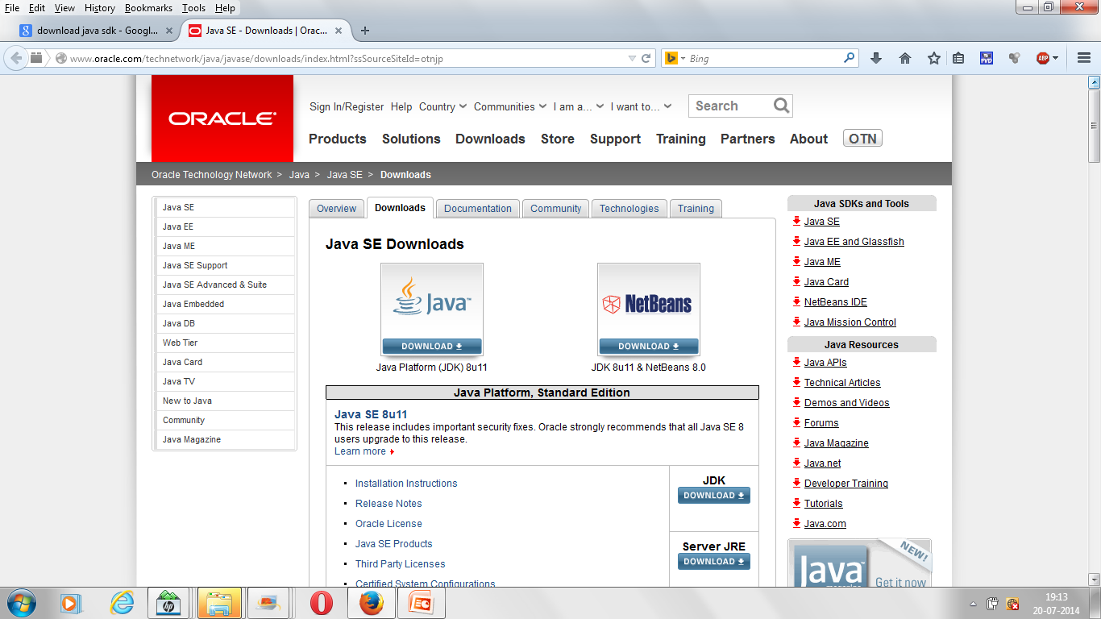
Downloading and installing JDK

Slide 27
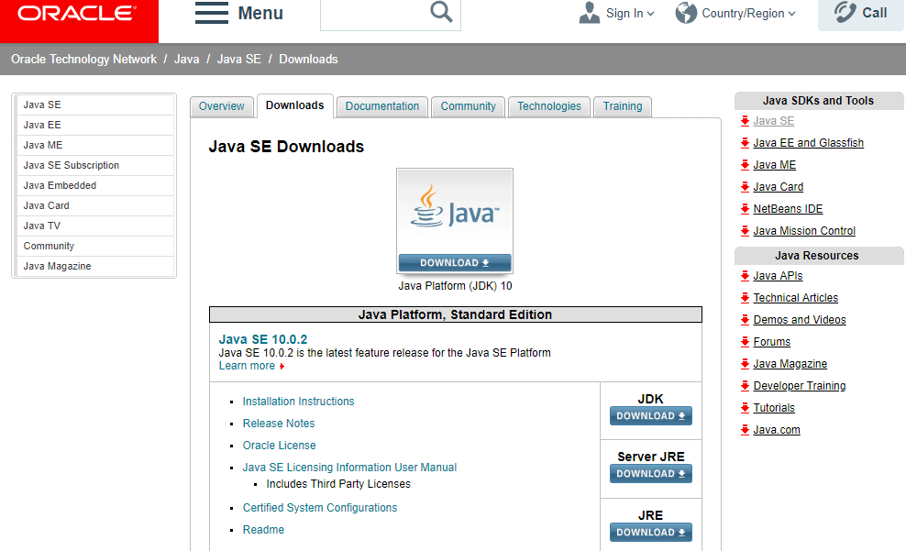
Downloading and installing JDK

Slide 28
Compiling & Executing Java Program
C:\ >jdk1.8\bin\ edit Example.java
C:\ >jdk1.8\bin\ javac Example.java
C:\ > jdk1.8\bin\ java Example
Hello World

Slide 29
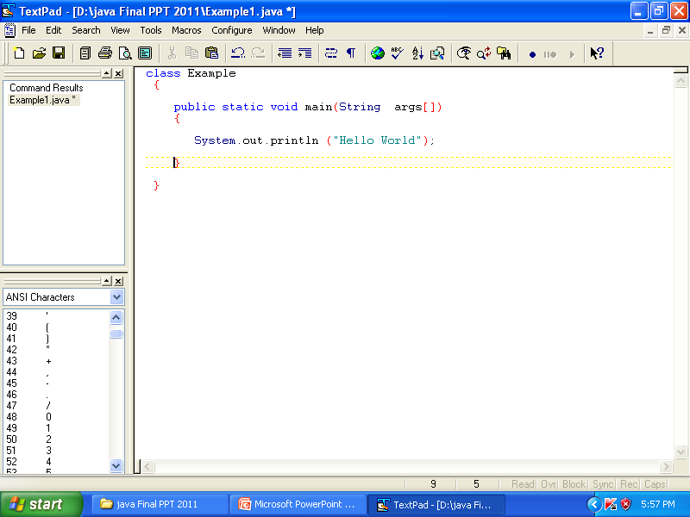

Slide 30
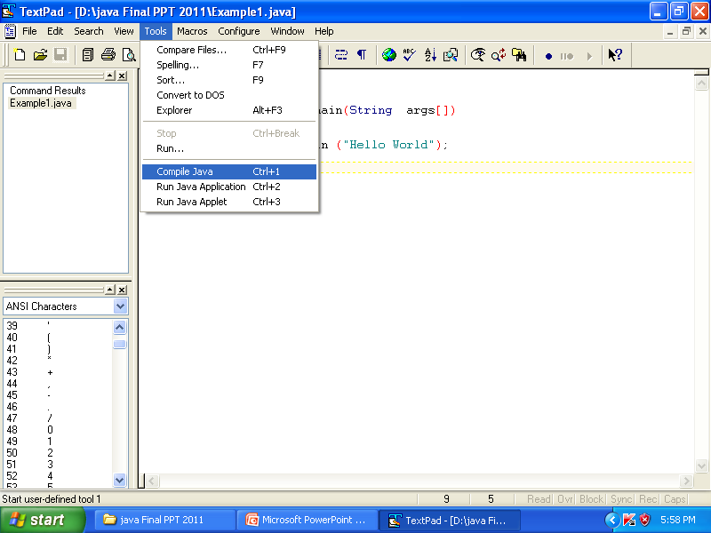

Slide 31
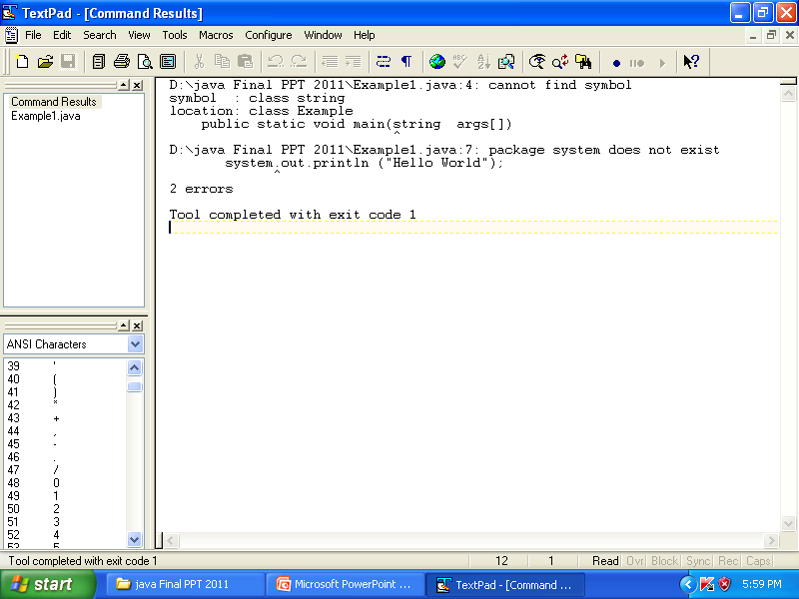

Slide 32
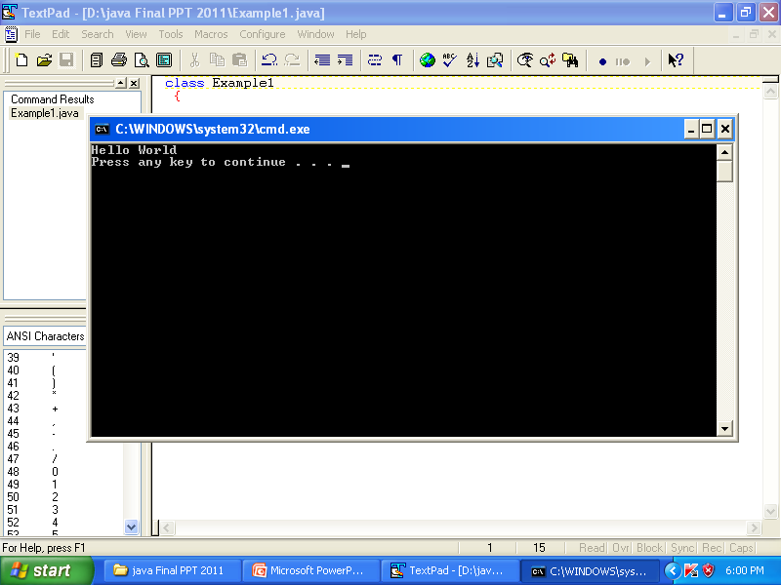

Slide 33
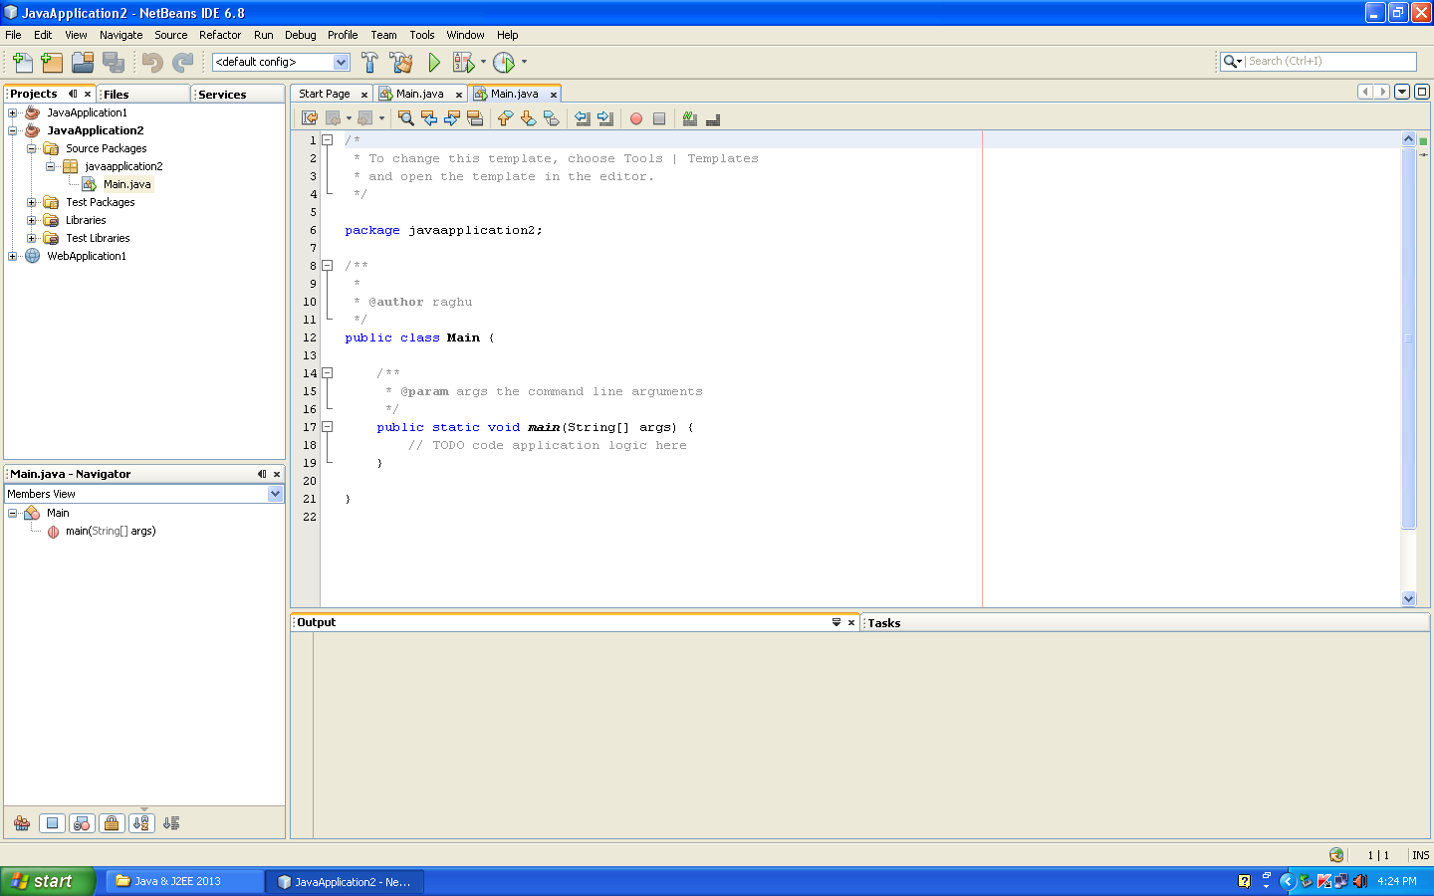

Slide 34
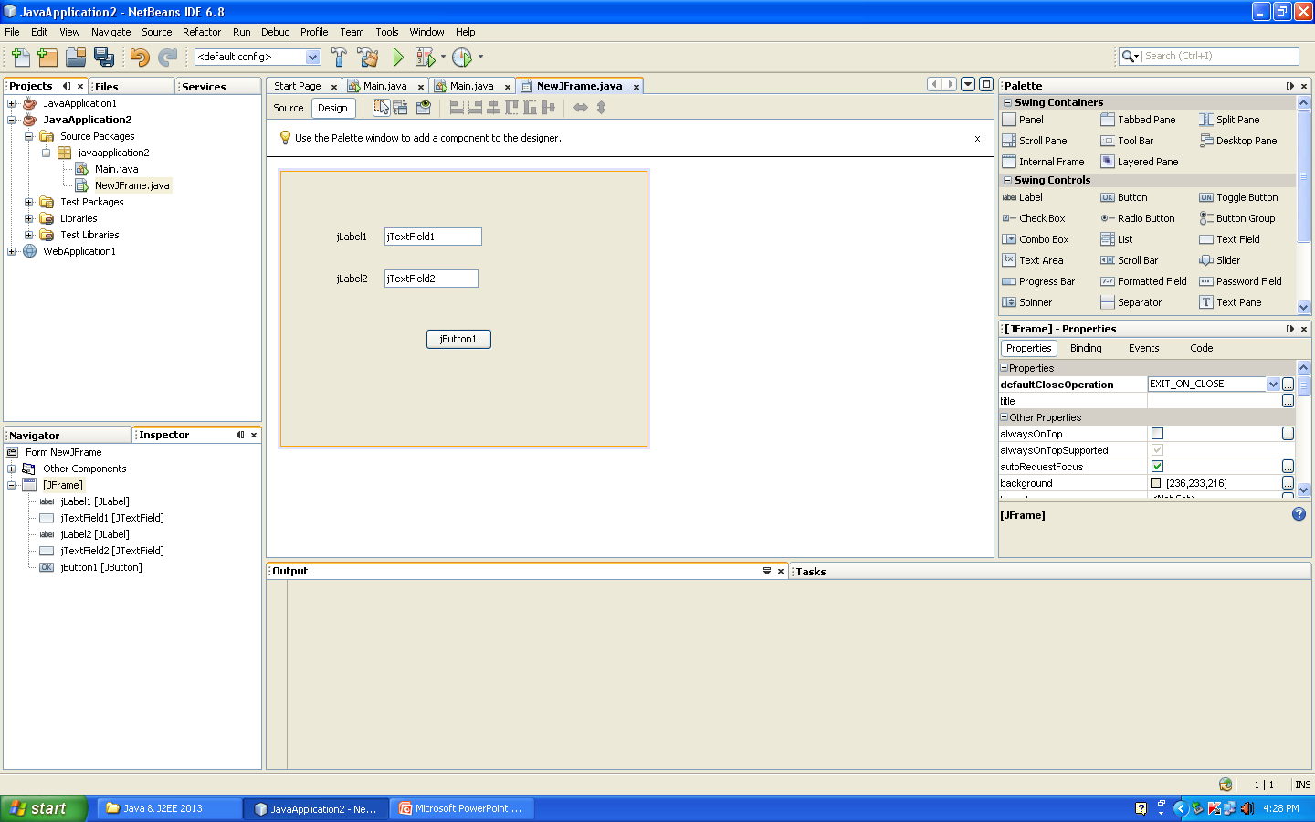

Slide 35
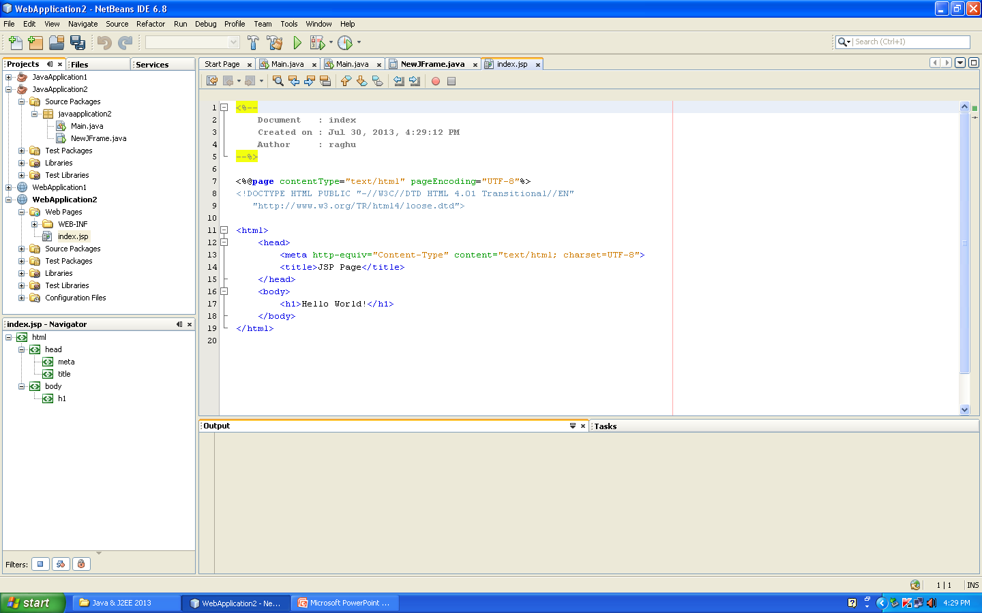

Slide 36
Example2 : Variable Declaration
class Example2
{ public static void main(String args[])
{ int a,b,c;
a=2;
b=3;
c = a+b;
System.out.println(c);
System.out.println(“sum is”+c);
System.out.println(“sum of”+a+”and”+b is”+c);
}
}
OUTPUT : 5
sum is 5
Sum of 2 and 3 is 5

Slide 37
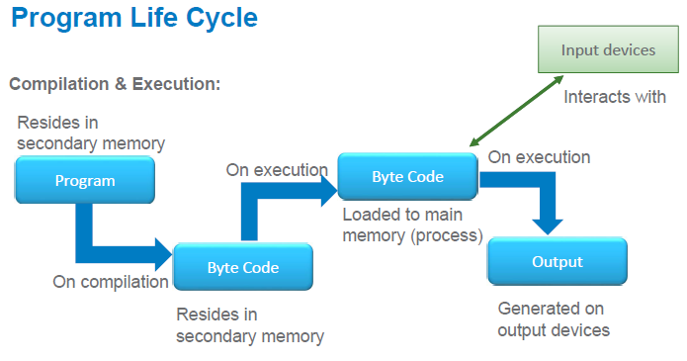

Slide 38
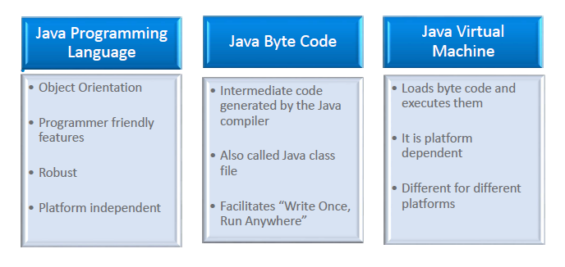

Slide 39
Java Virtual Machine (JVM )
The Java virtual machine (JVM) is a software implementation of a computer.
JVM executes programs like a real machine.
The JVM is written specifically for a specific operating system.
  e.g. for Linux a special implementation is required as well as for Windows.
Java programs are compiled by the Java compiler into bytecode.
The JVM interprets this bytecode and executes the Java program.

Slide 40
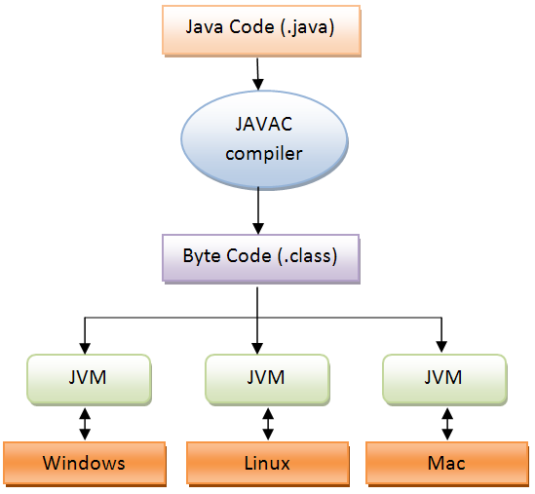
Java Virtual Machine (JVM )

Slide 41
Java Development Kit (JDK)
Java Runtime Environment (JRE)
Java Virtual Machine (JVM)
Jdk = jre + development tools
Jre = jvm + library classes

Slide 42
Java Language
A1.java
RAM
main()
{
f1()
f2()
}
JVM
Class loader
Byte code verifier
A1.class
A1.class
A2.java
A2.class
Execution engine
Garbage collector
f1()
{
}
compiler
A2.class
A3.class
A3.class
A3.java
f2()
{
}
when java command is executed an instance of JVM is created.
The class loader is responsible for bringing the class file into the JVM

